Slide 1
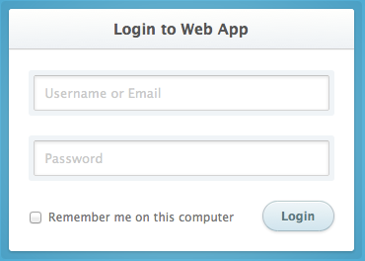
IDAX Dashboard – Prior to login
Cookies to store
Username from remember me
Auth token on successful login
Session idle time
(allow 10 minutes idle time?)
Register new account
Upon invalid attempt
Invalid login attempt
PHP Function calls
Login authorization attempt
Params: uname, pword, ipaddr & other session info
Returns: authtoken for user session on success or failed status (invalid uname/pword combo)
Create new account
Params: uname, pword, ipaddr & other session info
Returns: authtoken for user on success or failed status (invalid username)
Forgot your password? Click here to reset
Some background image

Slide 2
IDAX Dashboard – after successful login
Upload File
Generate Report
Current Site: none
Username
Logout
Cookies to update
Auth token on PHP calls
Session idle time, reset on interactions
Dropdown menu
PHP Function calls
Logout of session
Actions: Clean up local session files
Some background image

Slide 3
IDAX Dashboard – Upload file process
Cookies to update
Auth token on PHP calls
Session idle time, reset on interactions
Current file/site defined after successful upload
Upload File
Generate Report
Current Site: site location info
Username
Resulting upload snapshot view
Upload File
File picker
Input fields and options
PHP Function calls
Ingest file at location
Params: Authtoken, Ipaddr, filepath, site data…
Returns: success status
Upload
Some background image

Slide 4
IDAX Dashboard – Generate Report process
Upload File
Generate Reports
Current Site: site location info
Username
Cookies to update
Auth token on PHP calls
Session idle time, reset on interactions
Resulting report output snapshot view
Generate Reports
Select site: current site
Select report type
Set report crop options
PHP Function calls
Generate reports
Params: report options, report type
Returns: url filepath for reports to download
Generate
Some background image

